Slide 1
Controlling the Internal Environment
Part I: Excretory System

Slide 2
I. Water Balance and Waste Disposal
a) Single-celled organisms (bacteria, ameba, paramecium) rid themselves of wastes by diffusion across cell membranes into the outside environment directly. Waste is transported by water.
b) Multicellular organisms have a specialized excretory organ system to concentrate and remove wastes from the body fluids
These wastes diffuse from the body fluids into the blood.
These wastes eventually are accumulated in a structure from which they are excreted.

Slide 3
II. Waste Types
a) Cells produce the waste products water and carbon dioxide as by breaking down sugars, fats, and proteins by cellular respiration.
b) Nitrogen-containing wastes are produced by the breakdown (metabolism) of amino acids (which are the basic structures of proteins).
The constant production of wastes causes a large accumulation of water, carbon dioxide, and nitrogen-containing wastes in cells.
This high concentration of wastes causes it to diffuse out of the cells into the fluids of the body.

Slide 4
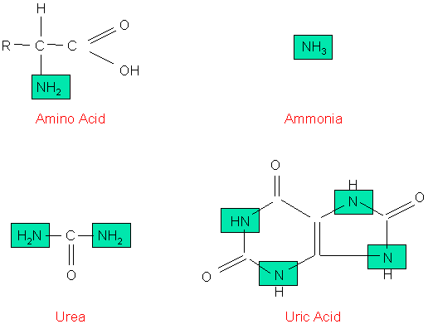
Nitrogenous Wastes
From: http://faculty.clintoncc.suny.edu/faculty/Michael.Gregory/files/Bio%20102/Bio%20102%20lectures/excretory%20system/excret1.gif

Slide 5
c) Types of Nitrogen Wastes
Nitrogen Wastes are produced by the breakdown of protein.
1. Ammonia
Aquatic (water dwelling) animals produce the highly toxic nitrogen waste called AMMONIA. Ammonia is VERY SOLUBLE in water and thus has a LOW WATER content.
2. Urea
Most terrestrial (land) animals usually need to conserve water. Amphibians and mammals produce the less toxic nitrogen waste called UREA (which is made in the liver).
Urea is filtered and concentrated from the blood by the kidneys.
3. Uric Acid
Birds and insects secrete the least toxic nitrogen waste called URIC ACID. Uric Acid is NOT VERY SOLUBLE in water and thus has a LITTLE WATER content.

Slide 6
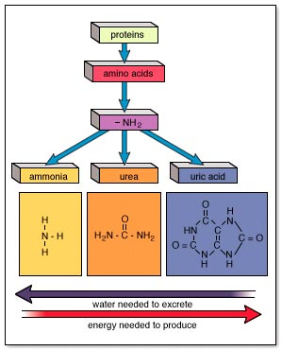
Nitrogenous Wastes and the Necessities of Water
From:http://www.mhhe.com/biosci/esp/2001_gbio/folder_structure/an/m9/s2/assets/images/anm9s2_1.jpg

Slide 7
III. Regulation of Extracellular Fluids
Excretory systems control the chemicals of the body by removing wastes and keeping the proper amounts of water, salts, and nutrients.
Parts of the human excretory system include the kidneys, liver, lungs, and skin.
NOTE: Elimination is the removal of feces.

Slide 8
IV. Excretory System Functions
Collect water and filter body fluids.
Filter out and concentrate waste products from body fluids for homeostasis.
Eliminate wastes from the body.
a) Vertebrates Excretory Organs
Vertebrates have paired (2) kidneys which control the contents of the blood and remove wastes.

Slide 9
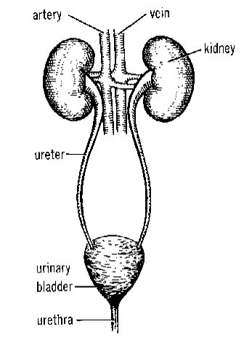
b) The Human Excretory System
1. The urinary system is made-up of the kidneys, ureters, bladder, and urethra.
2. Waste is filtered from the blood and collected as urine in each kidney.
3. Urine leaves the kidneys by ureters, and collects in the bladder. The bladder can distend (stretch) to store urine that eventually leaves through the urethra.

Slide 10
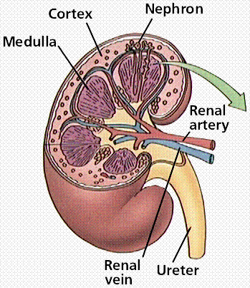
Structure of the Human Kidney
From:http://www.emc.maricopa.edu/faculty/farabee/BIOBK/BioBookEXCRET.html

Slide 11
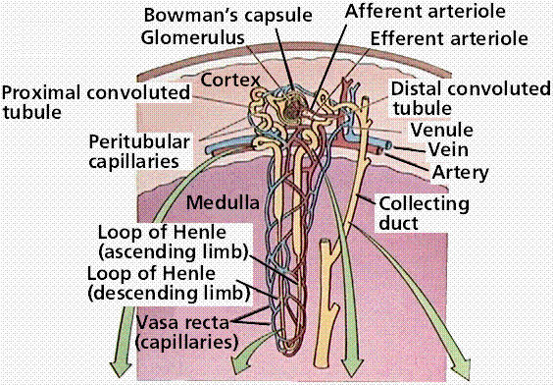
2. The nephron is the kidney's functional unit.
http://www.emc.maricopa.edu/faculty/farabee/BIOBK/BioBookEXCRET.html

Slide 12
The nephron consists of a cup-shaped capsule (Bowman’s Capsule) containing a network of capillaries (glomerulus), and a long renal tube.
Blood flows into the kidney through the renal artery, which branches into capillaries associated with the glomerulus.
Arterial pressure causes water and solutes from the blood to filter into the capsule.
Fluid flows through the proximal tubule, which include the loop of Henle, and then into the distal tubule.
The distal tubule empties into a collecting duct. Fluids and solutes are returned to the capillaries that surround the nephron tubule.

Slide 13
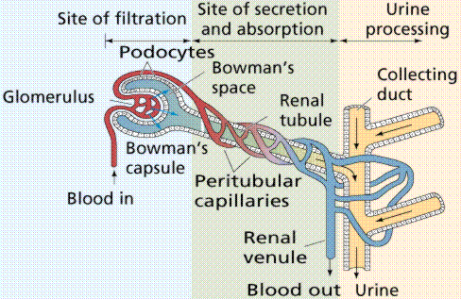
Filtration of the blood in the fine structure of the kidneys. Image from Purves et al., Life: The Science of Biology, 4th Edition, by Sinauer Associates (www.sinauer.com) and WH Freeman (www.whfreeman.com), used with permission.

Slide 14
d) Functions of the Nephron
1. Filtration of water, salts, urea, amino acids, and simple sugars from the blood.
2. Reabsorption of water, amino acids, and simple sugars back into the blood.
3. Secretion of ions and other waste products from surrounding capillaries into the distal tubule (concentration of urine).

Slide 15
e) Urine Production
Filtration in the glomerulus and nephron capsule.
Reabsorption in the proximal tubule.
Secretion in the Loop of Henle.
f) Components of The Nephron
Glomerulus: mechanically filters blood
Bowman's Capsule: mechanically filters blood
Proximal Convoluted Tubule: Reabsorbs 75% of the water, salts, glucose, and amino acids
Loop of Henle: Countercurrent exchange, which maintains the concentration gradient
Distal Convoluted Tubule: Secretion of potassium and certain drugs.

Slide 16
V. Hormone Control of Water and Salt
a) Antidiuretic hormone (ADH)
1. Water reabsorption is controlled by the in negative feedback.
Released from the pituitary gland in the brain.
When the amounts of fluid in the blood drop, the pituitary gland releases ADH into the blood.
ADH acts to increase water absorption in the kidneys by putting more water back in the blood.
When too much fluid is present in the blood, sensors in the heart signal the hypothalamus to cause a reduction of the amounts of ADH in the blood. This increases the amount of water absorbed by the kidneys, producing large quantities of a more dilute urine.

Slide 17
b) Aldosterone, a hormone secreted by the kidneys, regulates the transfer of sodium from the nephron to the blood.
1. When sodium levels in the blood fall, aldosterone is released into the blood, causing more sodium to pass from the nephron to the blood. This causes water to flow into the blood by osmosis.
c) Renin is released into the blood to control aldosterone.

Slide 18
VI. Kidney Stones
a) Excess wastes crystallize as kidney stones. They grow and can become a painful irritant that may require surgery or ultrasound treatments. Some stones are small enough to be forced into the urethra.
Disruption of Kidney Function
a) Infection, environmental toxins such as mercury, and genetic disease can have devastating results by causing disruption of kidney function. Many kidney problems can be treated by dialysis, where a machine acts as a kidney. Kidney transplants are an alternative to dialysis.

